Slide 1

Final Year Project
A3061-161
A Secure Online Quiz System (A)
Author: Bharti Rahul ● Matric Number: U1322950K ● Supervisor: A/P Chua Hock Chuan

Slide 2
Background
Formative Quizzes
Threats to fair test-taking
Use of python libraries and frameworks
Minimalistic UI
Need for continuous feedback to students
Reduce the hassle of dealing with cumbersome UI
Use python libraries to reduce boilerplate code
Scope of copying other students’ answers and hacking the system

Slide 3
Jargons Used
Online quiz system, referring to the project itself
4 types of Questions, Multiple Choice Ques, Multiple Choice Multiple Response Ques, Fill-in-the-blanks, Short Answer Ques
OQS
Flask
MCQ, MCMR, FIB, SA
ORM
A flask micro-framework used in web development
Object Relational Mapper, used to map objects to tables in Database

Slide 4
Objective
The aim of the project is to develop a secure online quiz assessment system using Flask stack (Linux, Flask, PostgreSQL, Python), JavaScript, Bootstrap, HTML5, and CSS3.
Basic Structure
Develop Plots
Basic Utility Tools
Documentation
Release

Slide 5
Database: PostgreSQL
ORM: SQLAlchemy
Framework: Flask
Server Side
Werkzeug
Template Engine: Jinja2
Web Server
Web Application Architecture
….
Browser: Chrome/Mozilla
Client Side​
HTML
CSS
JavaScript

Slide 6





Database (PostgreSQL)
Submissions
QnA
Users
Assessments
The main entities used in Database
Notes:
This was the basic dataset that was provided. From this the next sets of data were computed on the fly.

Slide 7
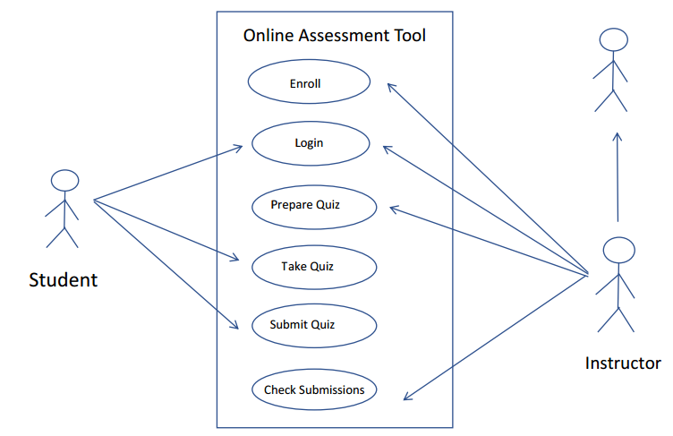

Use Case Diagram
Increasing Privilege

Slide 8
Project Fruits
Single Page View for question Addition
Add Parameterized questions
OQS
Minimalistic UI for test-taking
TIghten security measures

Slide 9
Lower Hanging Fruits
Add Parameterized questions
OQS
Minimalistic UI for test-taking
TIghten security measures

Slide 10
Tighten Security Measures
Measures against Cheating
Randomize the order of choices
Parameterize the questions
Measures against Cross-site request forgery (CSRF) and SQL-Injection attacks
Using FlaskForm
Using Javascript for Client side Validation

Slide 11
Minimalistic UI for Test taking
Minimal use of UI elements with focus purely on displaying the questions and answer choices.
Minimal number of steps for a student to take a test.
Enter Details, Click Login
Assessment Page
Fill out the answers, Click Submit
Login Window
Submission Page

Slide 12
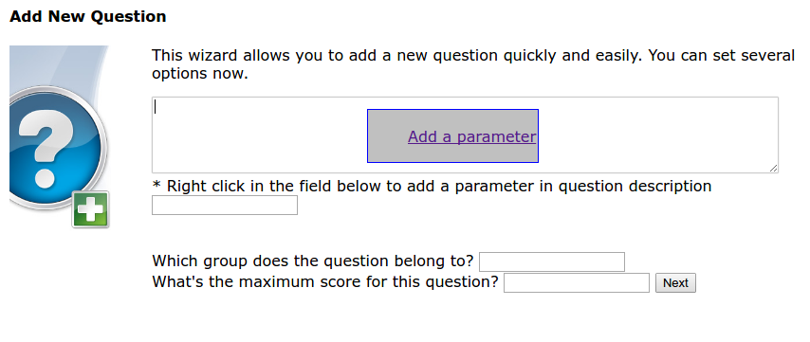
Parameterized Questions
Use of parameters helps with generating variations of same question.

Slide 13
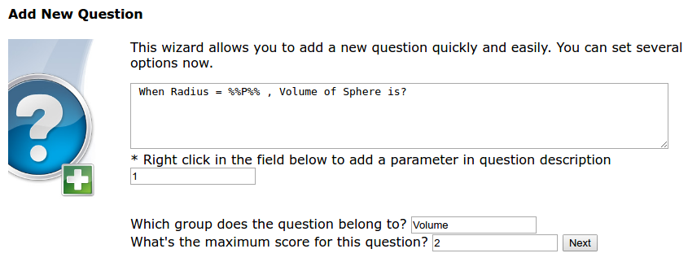
Parameterized Questions
Use of parameters helps with generating variations of same question.

Slide 14
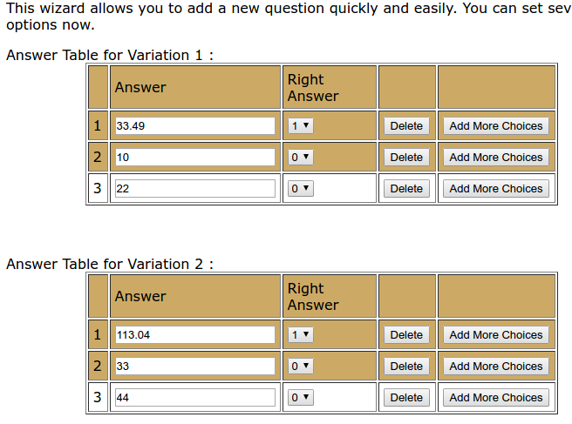
Parameterized Questions
Use of parameters helps with generating variations of same question.

Slide 15
Highly Placed Fruits
Single Page View for question Addition
OQS

Slide 16
Single Page View (SPV) Architecture
One of the key aspects - Make Question Addition Facility as smooth as possible by inculcating, SPV wherever possible.
The number of steps(page clicks) have been tried to reduce to as minimum as possible, However, One Single SPV wasn’t completely implemented.

Slide 17
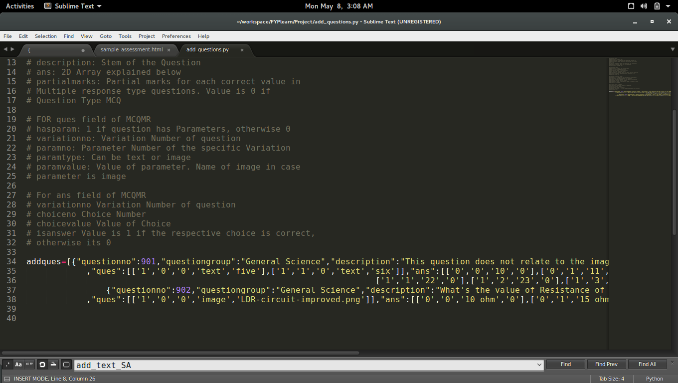
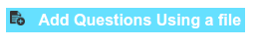
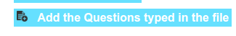
Alternative Solution
Uploading from a file facility has been added.
Click above link
Click Above Link
Add Questions in Text Editor
in required format

Slide 18
Future Work
Inculcating True SPV
Instant Feedback
Using NLP
Adding Audit Trail
Inculcate Single Page View Architecture in each aspect of question addition
Add a log file that stores every action for each instructor and Student.
Make quiz scoring more flexible by using Natural Language Processing for checking students’ answers in SA and FIB
Facility of giving instant feedback for each wrong answer by a student.

Slide 19
Conclusion
OQS was designed to improve the quiz taking experience of students and ease question addition process of instructors. The system was successfully designed using Flask microframework and SQLAlchemy ORM, thus reducing tons of boilerplate code. Most of the objectives were achieved, however, more work can be done in inculcating Single Page view Architecture. Furthermore, by using working on Future Work Recommendations, the quiz taking process can be made even more smooth and flexible.

Slide 20

Thank You

Slide 21
Final Year Project
A3061-161
A Secure Online Quiz System (A)
Author: Bharti Rahul ● Matric Number: U1322950K ● Supervisor: A/P Chua Hock Chuan

